Slide 1

UNIVERSITY OF PORT HARCOURT FACULTY OF ENGINEERING DEPARTMENT OF CHEMICAL ENGINEERING BASIC CHEMICAL STRUCTURE, ATOMS, MOLECULES, IONS
BY
Engr. J. N. PRINCE

Slide 2
Introduction
Background study:
In the late 19th century and early 20th century, PI and PID controllers were developed to enable some devices automatically maintain stability in the presence of disturbances. The first examples of PID controllers were developed by Elmer Sperry in 1911, and his son, Laurence Sperry in 1914. Nowadays, PID temperature controllers are applied in packing industries, industrial ovens, plastic injection machinery and hot stamping machines.

Slide 3
Introduction
Objective:
The main objective of this work is to control the temperature of a Continuously Stirred Tank Reactor (CSTR) system in the presence of a disturbance using PI and PID controllers.
Significance:
To increase the efficiency of Control engineers and enable them choose the best controller for a process.
To minimize the time spent in a process to get the desired result, thereby reducing cost.

Slide 4
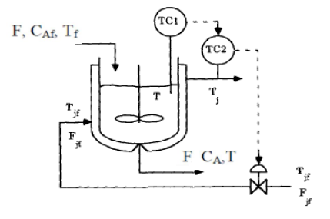
Review of Past Works
Continuous Stirred Tank Reactor (CSTR)

Slide 5
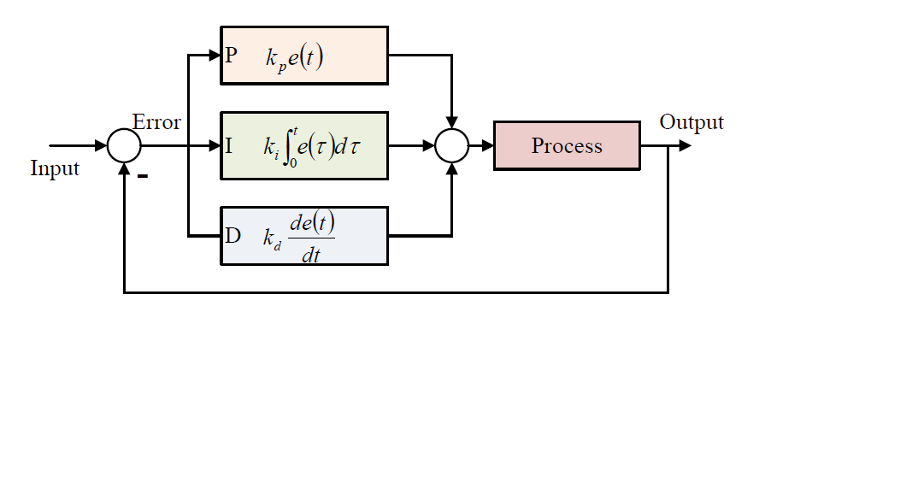
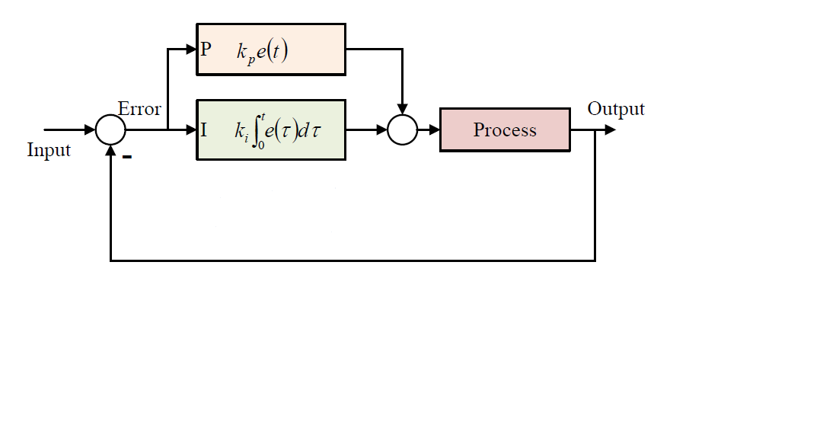
Review of Past Works
Proportional-Integral (PI) Control
Proportional-Integral-Derivative (PID) Control

Slide 6
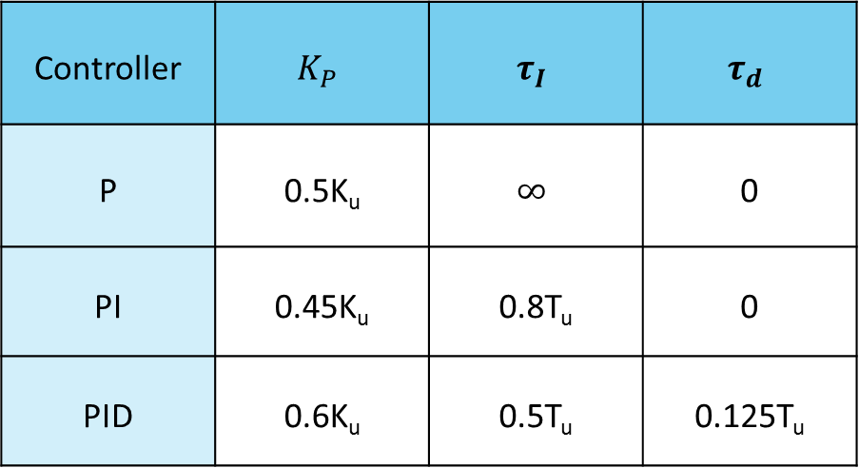

Review of Past Works
Zeigler-Nichols Rules for Tuning Controllers
Controller | $$K_{P}$$ | $$τ_{I}$$ | $$τ_{d}$$
P | 0.5K_{u} | $$∞$$ | 0
PI | 0.45K_{u} | 0.8T_{u} | 0
PID | 0.6K_{u} | 0.5T_{u} | 0.125T_{u}
$$K_{I}=\frac{K_{P}}{τ_{I}}$$
$$K_{D}=K_{P}×τ_{d}$$

Slide 7
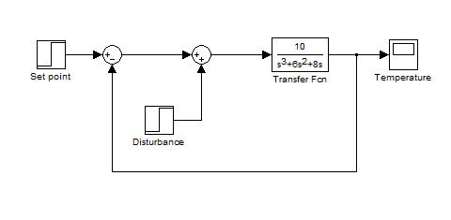

Methodology
Transfer function, $G_{(s)}=\frac{10}{s^{3}+6s^{2}+8s}$
Process model

Slide 8
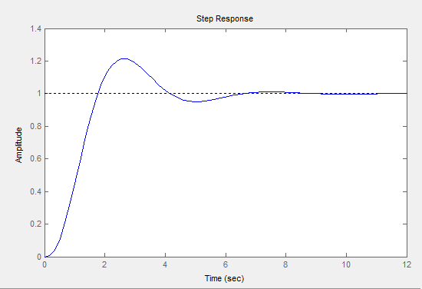
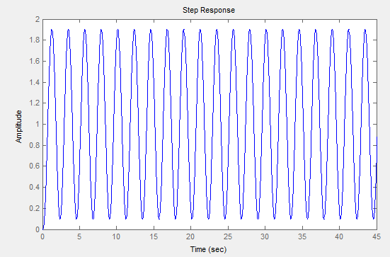
Methodology
By Trial and Error method of Sisotool in MATLAB, the Ultimate gain K_{u} is found when stability achieved
K = 1
K = 4.8

Slide 9
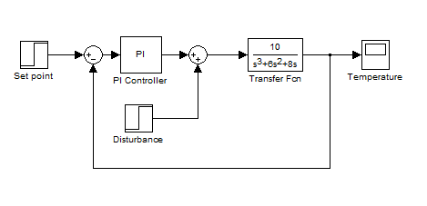
Methodology
Process model with PI Controller

Slide 10
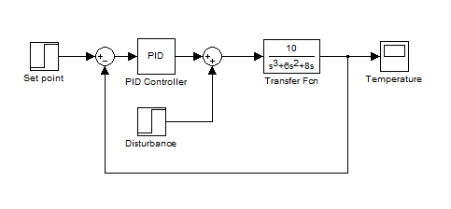
Methodology
Process model with PID Controller

Slide 11
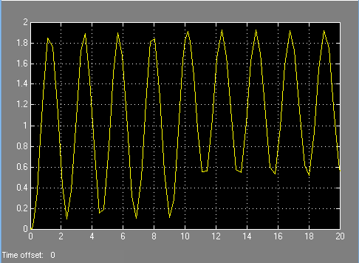
Result and Findings
Ultimate gain K_{u} = 4.8

Slide 12
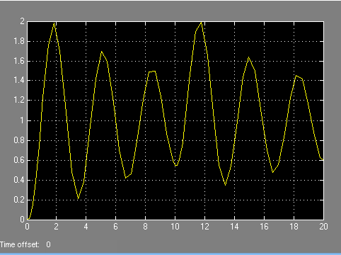

Result and Findings
Temperature output response of Process with PI controller
For Set Point Tracking
Settling time: $∅$
Overshoot: 98.3%
For Disturbance Rejection
Settling time: $∅$
Peak deviation: 98.8%

Slide 13
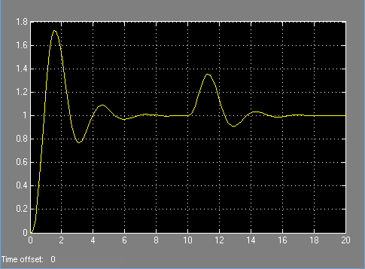
Result and Findings
Temperature output response of Process with PID controller
For Set Point Tracking
Settling time: 6.81secs
Overshoot: 72.6%
For Disturbance Rejection
Settling time: 6.55secs
Peak deviation: 35%

Slide 14
Conclusions
For PI control, Set point tracking Settling time is not feasible within the simulation time and the Peak overshoot is 98.3%. Also the Disturbance rejection Settling time is not feasible and the Peak deviation is 98.9%.
For Set point tracking, Settling time and Peak overshoot with PID control is 6.81secs and 72.6% respectively. For Disturbance rejection, Settling time and Peak deviation is 6.55secs and 35% respectively.
In terms of Set point tracking and disturbance rejection, the PID controller provides better settling time than the PI controller.

Slide 15
Recommendations
If fast response of the system is required, it is preferable to use the PID control. Otherwise, the PI control could be used.
Other faster controls such as Fuzzy Logic control and Cascade control can be used for faster response of the system with lesser settling time.

Slide 16
THANK YOU
THANK YOU
THANK YOU
QUESTIONS?

